Slide 1
Proto Types
Andri,Bergvin,Svanur,Garðar,Einar

Slide 2
Test case 1 teacher:
Login and create new assignment for c++ programing language in the course Forritun 1.
Make the start date 01/4 at 10:00 and the end date 08/4 at 23:59, upload description and output to compare with students output.

Slide 3
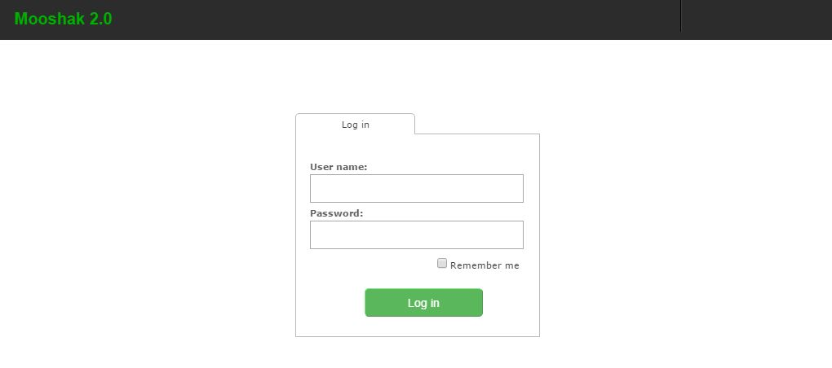

Slide 4
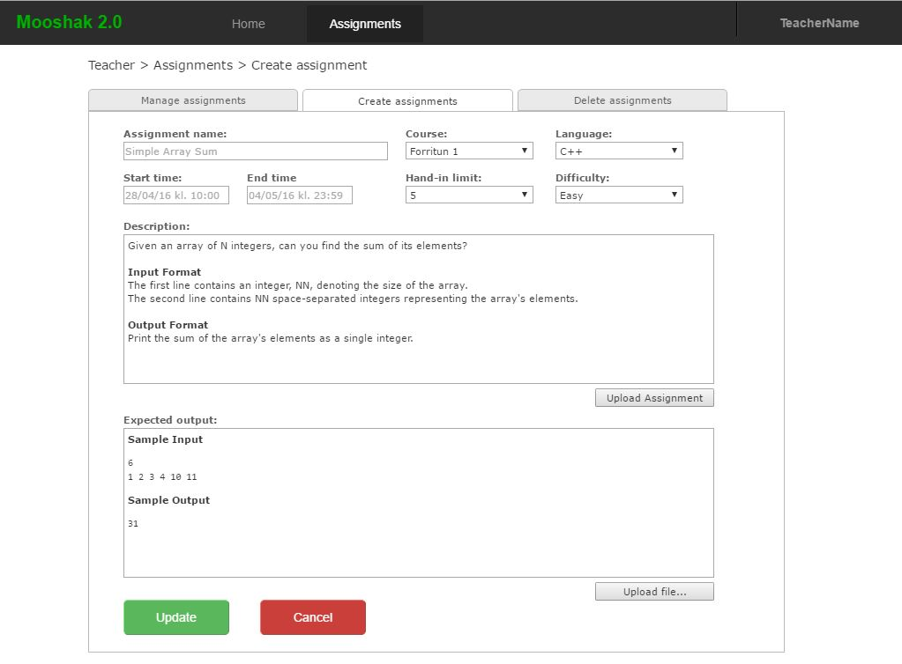

Slide 5
Measurable goals
V1. Create new assignment
1. 80% users will be able to finish this task
2. Those users that are able to finish will do so under 4 min.
3. Users satisfaction will be 8 or higher on the scale 1 – 10

Slide 6
Test case 2 student:
Login and submit an assignment to the course Forritun 1 and see if you get accepted.

Slide 8
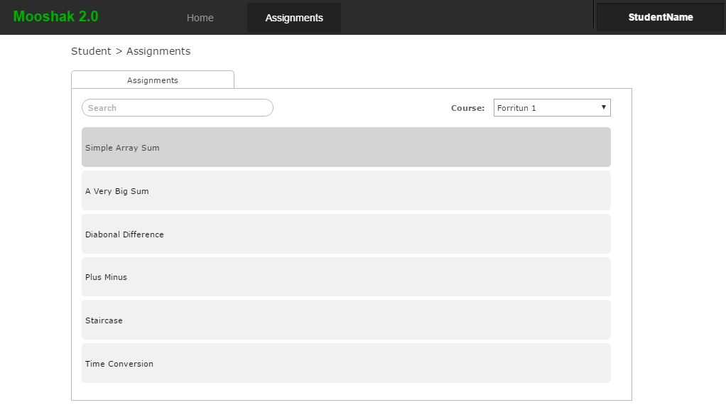

Slide 9
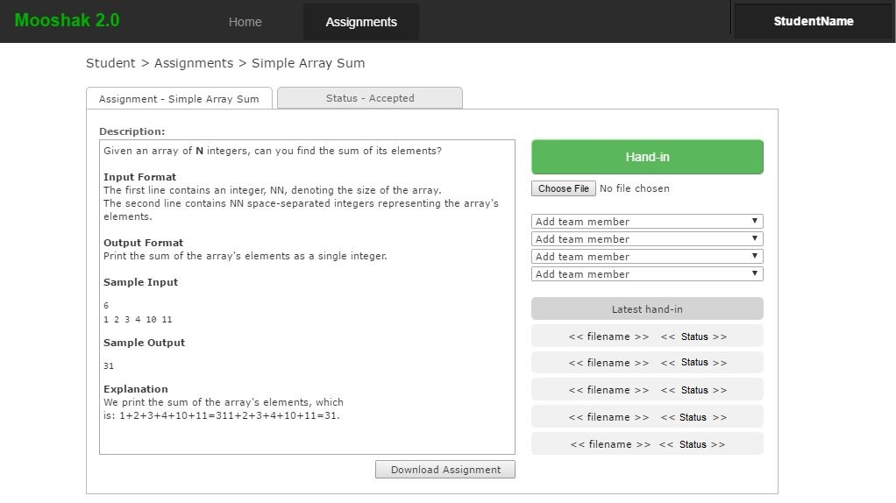

Slide 10
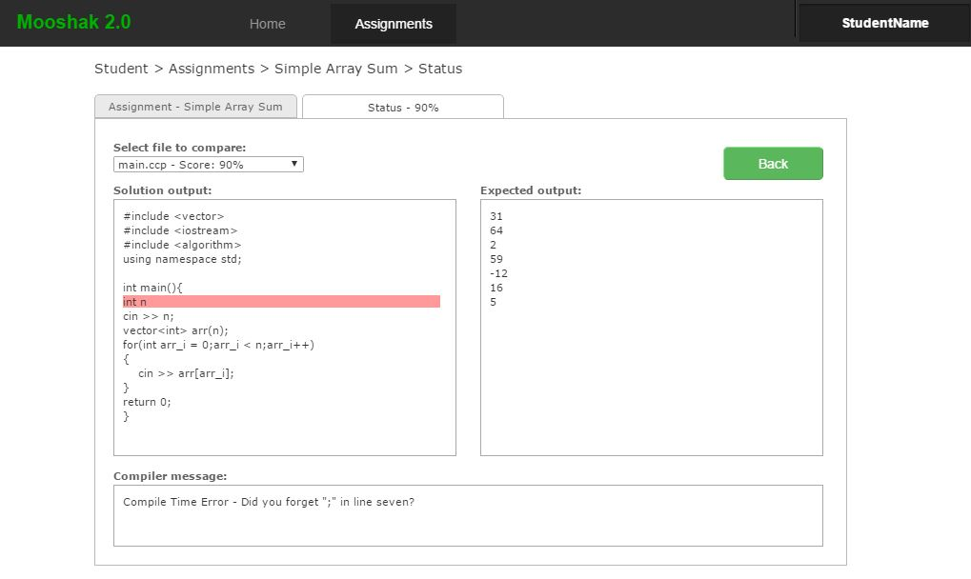

Slide 11
V2 Submit assignment
1. 90% users will be able to finish this task
2. Those users that are able to finish will do so under 2 min.
3. Users satisfaction will be 8 or higher on the scale 1 – 10

Slide 12
Test case 3 admin:
Login as admin and create a new course named Forritun 2 and link a teacher to that course named Jón Jónsson.

Slide 14
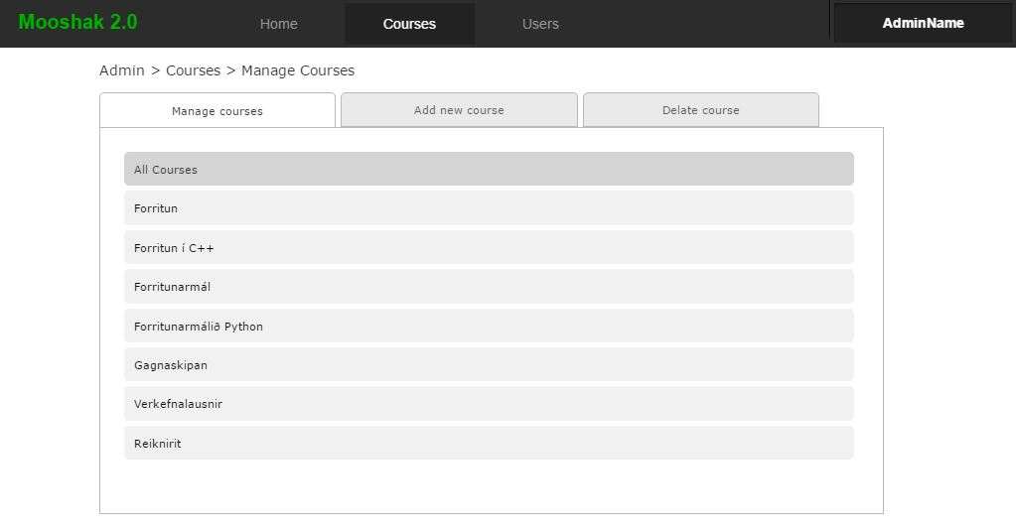

Slide 15
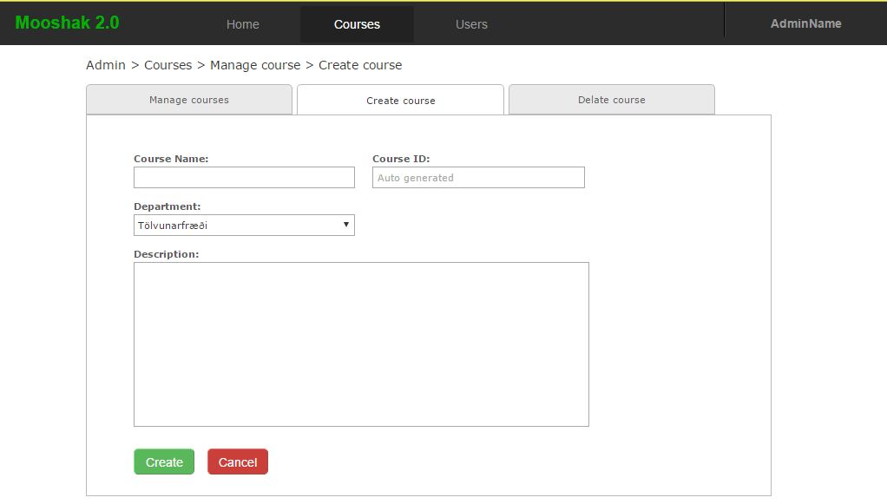

Slide 17
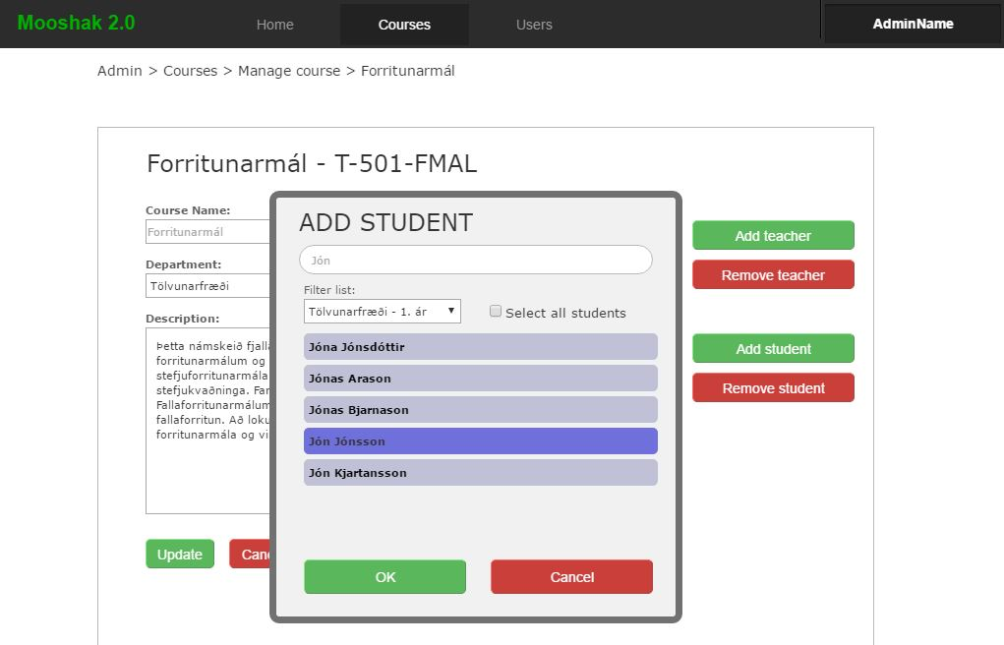

Slide 18
V3 Create new course
1. 90% users will be able to finish this task
2. Those users that are able to finish will do so under 3 min.
3. Users satisfaction will be 8 or higher on the scale 1 – 10

